Slide 1
How to Find Relationship among Variations
Xianzhe Meng 2025.7.10

Slide 2
Catelogue
1.typical statistical methods
2.modern algorithms
3.further thinking

Slide 3
Motivation
Basic Values for Independence Analysis
1.Forecast
 | Positive Prediction | Negative Prediction
Positive Outcome | TP | FN
Negative Outcome | FP | TN
2.Adjust
3.Motivation for Further Study
BASIC:TPR,FPR,Accuracy,Sensitivity,Specificity,PPV,NPV
SQUARE:AUPRC,AUROC
OTHERS:F1,Cohen’s Kappa
4.Statistical Function Fitting
Basic Values for Single Data
Data Source
Central Tendency:mean,median,mode,quantile,Q1,Q3
Dispersion Tendency:max,min,std,range,Cov,IQR
Distribution Shape:skewness,kurtosis
MIMIC-III
EEG,ECG,Glucose,gait data,EHR,PPG,EMG,IMU,Antigraph
i.e. differences for GA forecasting in mortality prediction,length of hospital stay,disease prediction

Slide 4

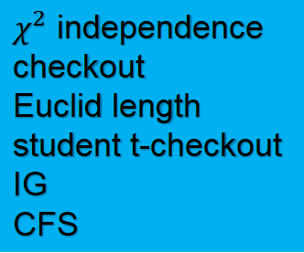
Modern Methods
feature selection
misleading
How we reduce dimension?
feature extraction
redundant
transformation
feature classfication
irrelevant
embedded / hybrid > wrappers > filters
Relief Algorithm
filter:
Correlation Based Method
Information Gain
MI
BW-ratio
INTERACT
wrapper:
SVM
GA
mRMR
PAM
hybrid:
filter+wrapper
FSA
$χ^{2}$ independence checkout
Euclid length
student t-checkout
IG
CFS
PCA
ICA
Non-linear PCA
PPCA
KPCA
SVD
relevant,irrelevant,redundant features

Slide 5
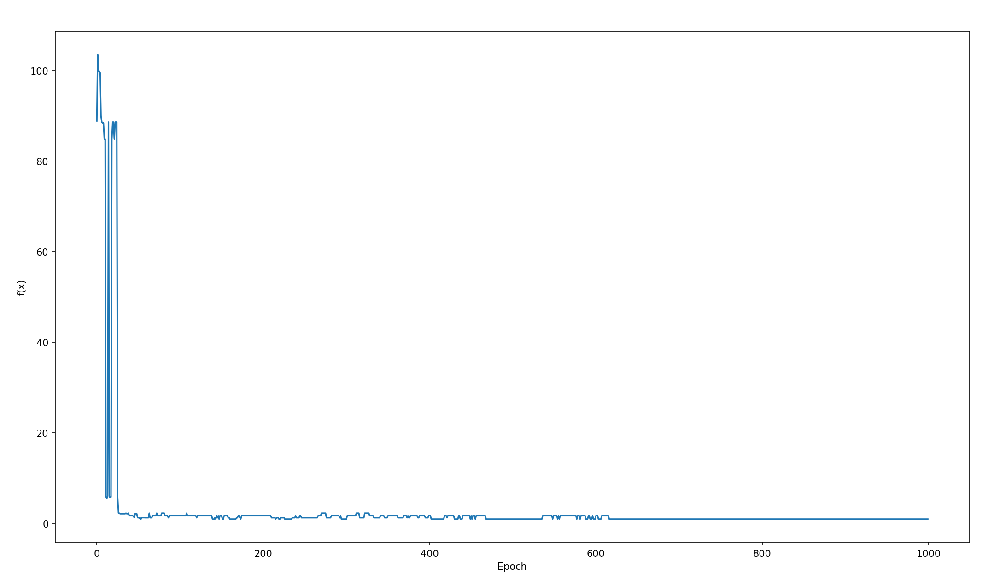
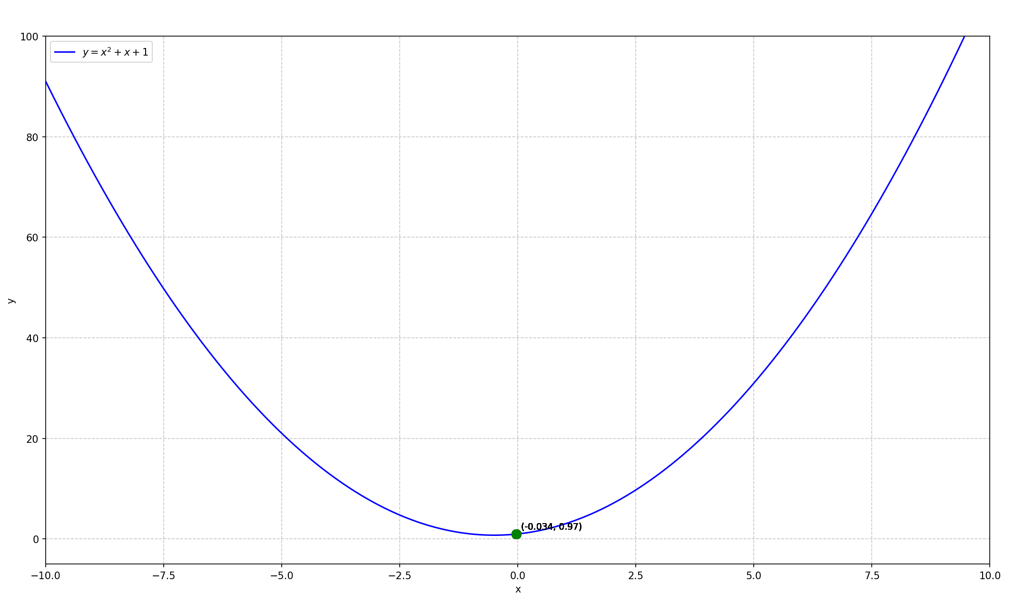
code recurrence for GA

Slide 6
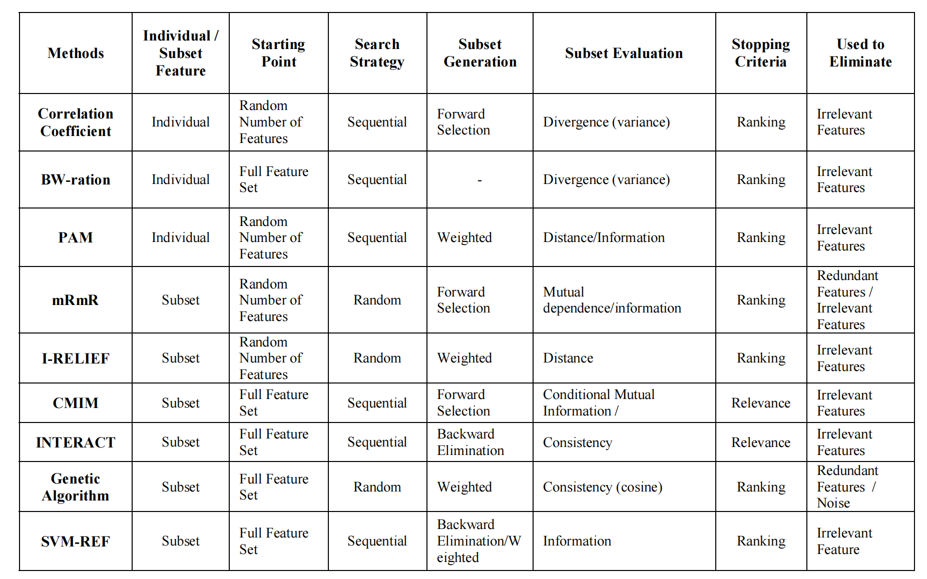
linear
difficult for complex relationship
sometimes lose valid groups
unstable;no optimization
good for high dimension but easy to fluctuate
catch part difference,huge calcultaion
precise for independent features,huge calculation
purification,huge calculation
global optimisation,long time
select important feature,huge calculation

Slide 7
PCA | Pricipal Component Analysis,Unsupervised learning
ICA | Independent Component Analysis
Non-linear PCA | Save features
PPCA | Anti-noise
KPCA | Product in high dimensions
SVD | High Stability
IG | One of the most distinctive features
CFS | Take correlation into account , Suitable for multiple tasks

Slide 8
Challenges We meet
1.How to precisely display relationships among data?
2.overfit
3.How can we shorten confidence interval?
4.How can we optimize complexity?
5.How can we find suitable features?
Modern Methods
DL
GA
RF
SVM
chaos theory

Slide 9
Further Thoughts
1.As for overfitting,can we axiomatize and define the most precise meaning of overfit?
How can we put forward a heuristic algorithm based on the axiomatization,
s.t. we can prevent overfitting using only partial dots?
Or just raise a theory of “partial overfit”,and by the algorithm,we prevent most of overfitting?
Why is the study remains blank?
2.How can this study be applied in medical treatment?
3.Is there a new algorithm or new value representative to solve the problem?Why we choose the algorithm that can’t be proved to be optimal? Can we precise them by using maths?
4.A kind of new algorithm

Slide 10
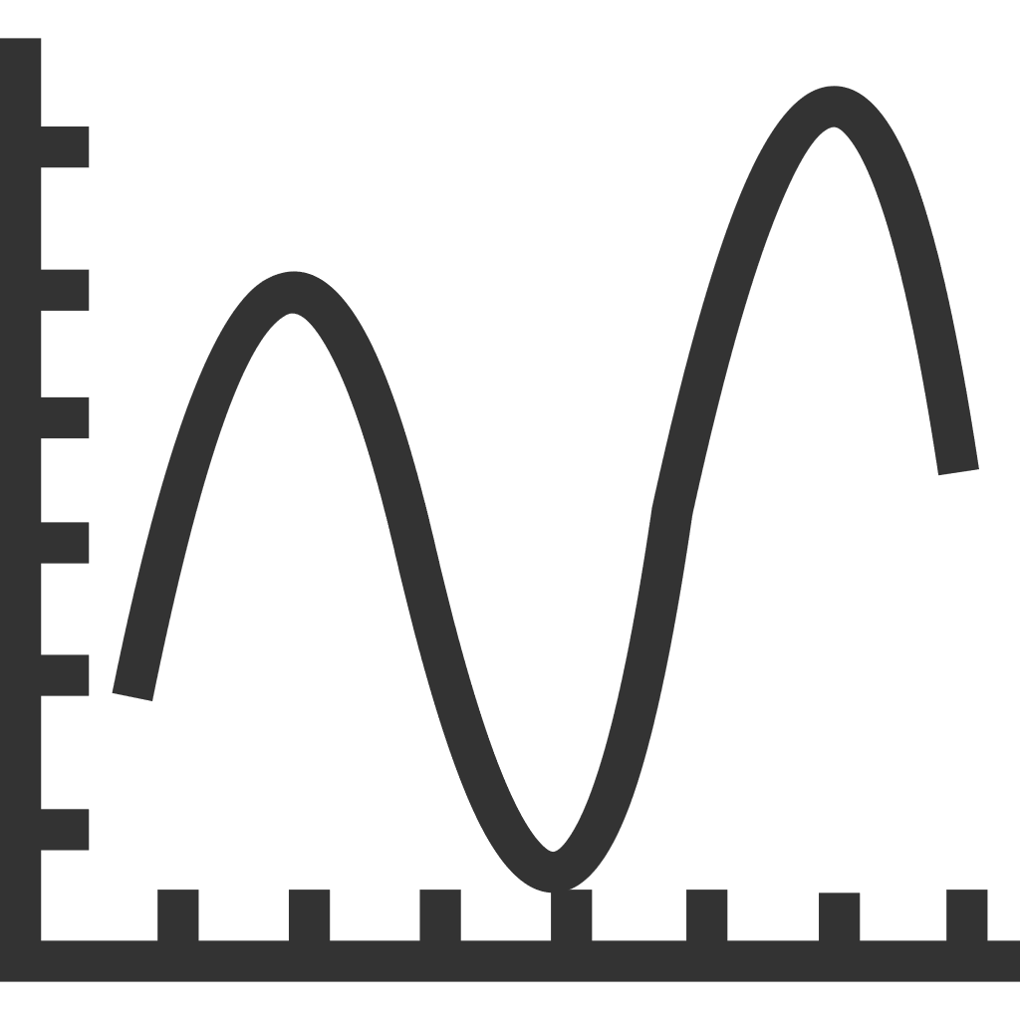
New Methods:
Step 1:
Filter the noise and get true answers
noise=probability density×how hard it fluctuates
Step 2:
Get new dots and iterate
Termination:
Traditional
For two dots,interval < ε
How we get the dots:
Advantage:
We don’t need to show the function and this function can have the ability not to be limited by just a few typical functions,like ReLU,tanh,etc.
And maybe time complexity can be optimised.
mean of two close dots
Challenges
How?

